Slide 1
Software Construction
software release management
“…Predictability is one of IT's most elusive goals…”

Slide 2
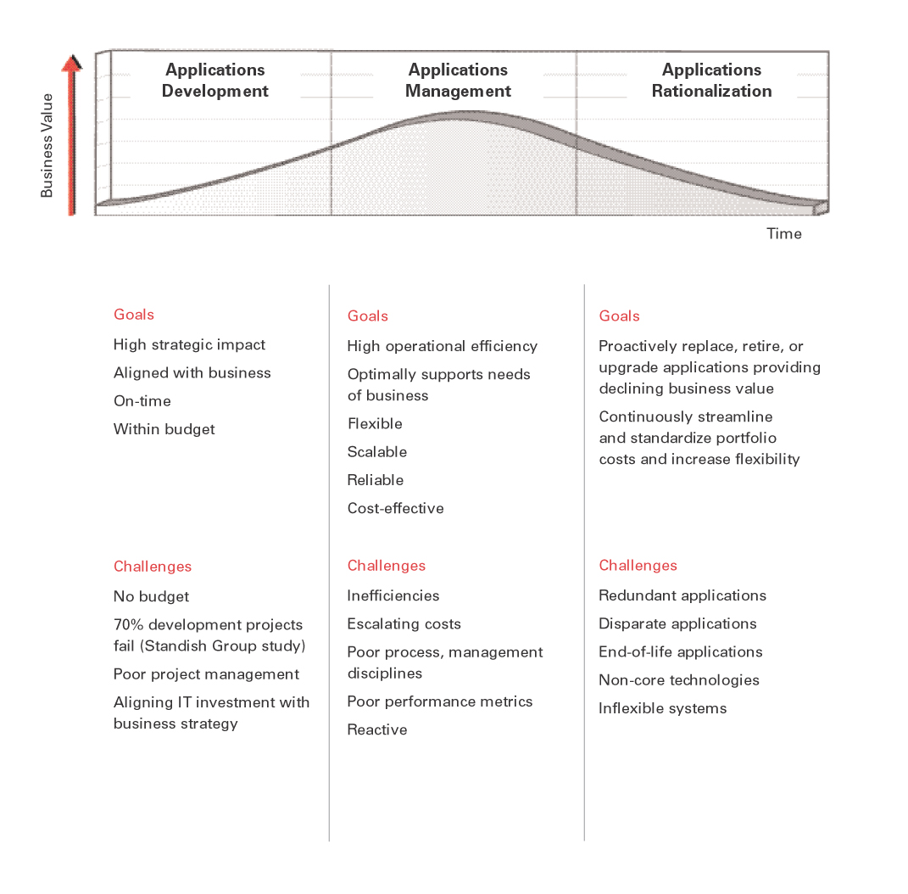
Systems Lifecycle

Slide 3
Application Management - Typical Problems
Inability to track and manage multiple projects affecting the same or multiple systems with multiple end dates and multiple business owners.
Lack of predictability in delivery timeframes, costs, and support requirements.
IT: “You will get it next phase…” Business: “Yeah right…”
Escalation management paradigm <squeaky wheel syndrome followed by whiplash syndrome>.
Total breakdown in business owner confidence and trust (credibility) in IT’s ability to deliver.
Risk to application uptime.

Slide 4
A Solution!!!!
Release Management

Slide 5

A model of predictability

Slide 6
What is Release Management?
Release Management (aka Release Train) can be defined as a methodology for planning and implementing an integrated set of functional components and processes in a controlled manner.
Date driven; releases are scoped in order to meet pre-specified delivery dates, the project management “Iron Triangle” balanced on the schedule annex.
Reversed planned; start with your target implementation dates and work backwards.
Mechanized; process should try to emulate a typical factory operation.
Forecasted schedules as well as functionality; force an organization to strategize and plan in advance.
Integrated and predictable; many business needs folded into one release, and everyone knows the schedule.
Uses standard system development lifecycle (SDLC) and project management methodologies (PMBOK) and best practices

Slide 7
Benefits of Release Management
Provides for an integrated (and transparent) view of both business and IT plans
Open planning can provide a clear view of what is being developed, and when the key milestone will be achieved.
Results in a more stable production system
The introduction of an integrated release early in the development cycle allows for more careful analysis and testing of impact to normal operations.
Creates predictability in delivery timeframes, costs, and support requirements
Release Management provides all corporate entities with a clear view of the functionality being delivered and release scheduling, both in the short and long run.
Allows for the utilization of corporate resources consistent with corporate priorities
Used by many large organizations such as Cisco, Sun, etc.

Slide 8
Release Management Release Planning
What are the systems? Is there a grouping of systems?
How many releases?
When to release?
How much overlap?
Q1 04
Q2 04
Q3 04
Q4 04
Q1 05
J
F
M
A
M
J
J
A
S
O
N
D
J
F
M
Release 1
Release 2
Release 3
Release 4

Slide 9
Release Management Rigidity versus flexibility
Rigidity of the release schedule is dependent upon the organization implementing Release Management.
Typically, there is a process for introducing “Hot Fixes” in between release deployment dates.
Constrained to only include Priority 1 system bugs, or “Business Critical” enhancements.
Exceptions and not the norm, otherwise the organization risks losing the benefits.
Determine, well in advance, the number and type of Hot Fixes the RM team can absorb without putting the release in jeopardy.
To allow for some level of flexibility, the release dates can be given a plus or minus factor.
Allow the team to either expand or contract the release schedule depending on different constraints.
Changes to release dates will cascade down to subsequent releases, therefore Change Management is critical.

Slide 10
Release Management Multiple Systems/Multiple Business Requests
Typically with an enterprise, there are a series of systems that may be either tightly or loosely coupled.
Groupings of systems; i.e. Provisioning Systems versus Operations Systems
Upstream versus downstream
There may be any number of organizations with business requests resulting in development on one or more of the systems.
May or may not have shared needs or competing needs
Need must be integrated
Release planning sessions that include all appropriate organizations from the lines of business and IT.
Determine the critical scope or “Anchor Functionality” and the reserve for unknown functionality.
Rolling 12 month view of the release plan, therefore meet regularly.

Slide 11
Release Management Release Roadmap
Q1
Q2
Q3
Q4
Q1
J
F
M
A
M
J
J
A
S
O
N
D
J
F
M
Project 1a (OPS)
Project 2 (Strategy)
Unknown (5%)
Project 1b (OPS)
Project 3 (Engineering)
Project 5 (OPS)
Unknown (10%)
Project 1c (OPS)
Project 6 (Engineering)
Unknown (25%)
Release Package 1
15-Aug-05
Release Package 2
15-Dec-05
Release Package 3
15-Apr-06
Q1
Q2
Q3
Q4
Q1
J
F
M
A
M
J
J
A
S
O
N
D
J
F
M
Requirements
Freeze
Scope
Freeze
Development
Testing
Deploy
Requirements
Freeze
Scope
Freeze
Development
Testing
Deploy
Requirements
Freeze
Scope
Freeze
Development
Testing
Deploy

Slide 12
Release Management Integration Points
Need to determine where an integration point should be planned within the RM lifecycle.
May be a temptation to only concentrate on those functionalities that appear, during analysis phase, to be interrelated.
Business Request 1
Business Request 2
Business Request 3
The development of all requests are completed on or near same date. All move in uniform fashion to integrated testing
All business requests are scoped as one release.
All requirements are reviewed in an integrated fashion
Requests are gated prior to deployment and deployments are coordinated to include 1 to n business requests.
No Release management
Requirements
Baseline
Scope
Baseline
Development
Complete
Quality Control
Complete
Deployment

Slide 13
Release Management Make if official
Use System Development Lifecycles (SDLC) such as the Waterfall or Rational Unified Process (RUP) approaches.
Use Project Management best practices, i.e. PMBOK.
Each release could be viewed as a project.
Formally document the policies and operating principles, such as:
Scope Management
Metrics Management
Quality Management
Change Management
Strategic Release Planning
Integrated Testing
Risk Management

Slide 14
Release Management Roles
Release Manager
A project manager whom manages release.
The release, the whole release and nothing but the release.
Must be thick skinned!
Business Project Manager
Focused on the business needs.
Natural tension with Release Manager.
Development Manager
Configuration Manager
Environments Manager
Testing Manager

Slide 15
Release Management Information Management Tools
Release Management Planning and Deployment tool (RMPD)
Tracking of multiple business requests, the associated software deliverables of those requests, as well as release planning and scheduling, and the association of software deliverables contained within a release.
Open-view of planned releases and the functionality for each release.
Automate additional Project Management tasks geared towards the release.
Integrated with other IT tools, such as Defect Tracking, Budgeting, etc.
There is not a strong suite of tools currently available for managing the release management process.
Maybe the Rational Suite
MS Excel
MS Project
Homegrown

Slide 16
Release Management Summary
IT organizations are losing credibility due to their inability to provide predictability in software delivery timeframes, costs, and support requirements. This is particularly evident during the Application Management phase of a systems lifecycle.
Release Management is a methodology that provides predictability, stability and transparency to software delivery.
Planning, planning, planning.
A release in June might start in January
Scope takes a back seat to schedule.
Not a silver bullet, the implementing organization must truly understanding the business objectives and the tradeoffs.

